Slide 1
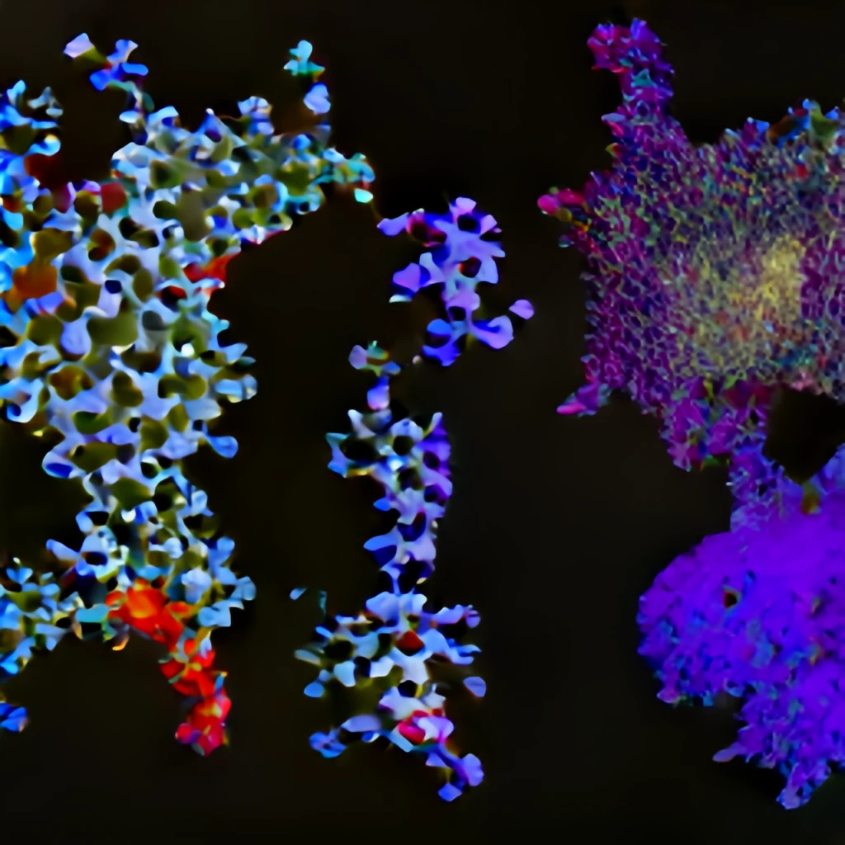



Exploring new frontiers in drug discovery using deep generative models
Dr. Rocío Mercado
Incoming Assistant Professor, Data Science & AI (DSAI), Chalmers
ailab.bio
ChE-651 Seminar, EPFL
Tuesday November 8, 2022

Slide 2
Outline
Introduction
Building & benchmarking molecular deep generative models (DGMs)
Exciting applications of molecular DGMs
Summary & outlook
Acknowledgments
References for further reading

Slide 3
Introduction

Slide 4
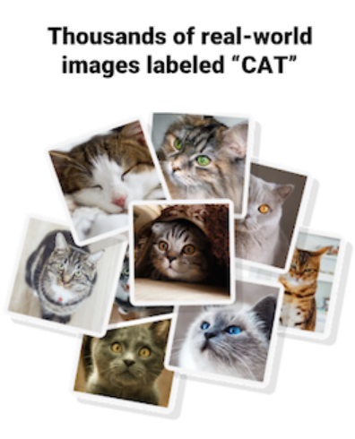
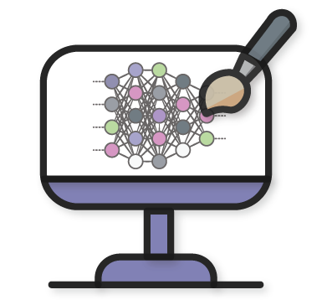
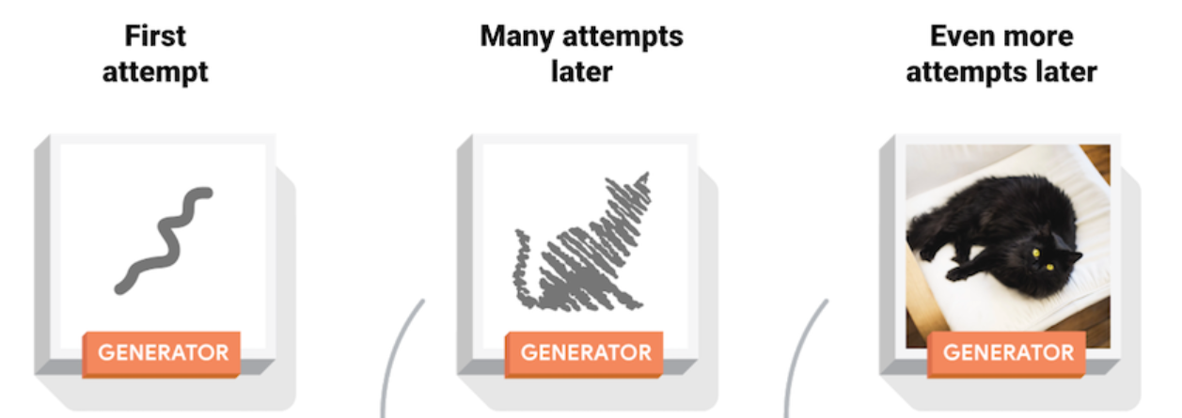
What are generative models?
Generative models are models which can generate new data instances.
Deep generative models, or DGMs, use deep neural networks.
example data
new data
DGM
developers.google.com/machine-learning/gan/generative
tensorflow.org/tutorials/generative/dcgan

Slide 5
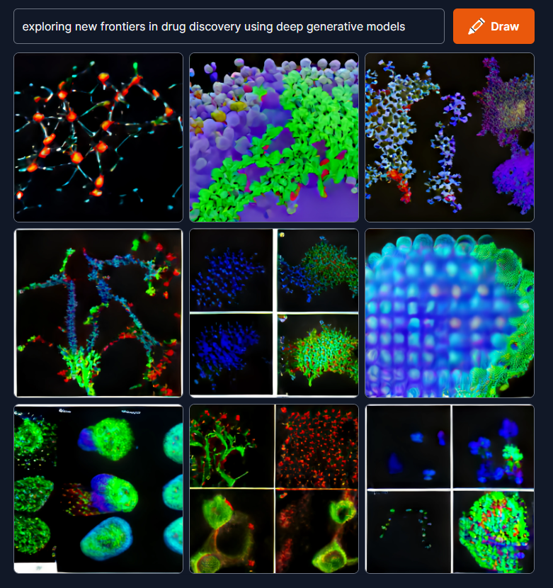
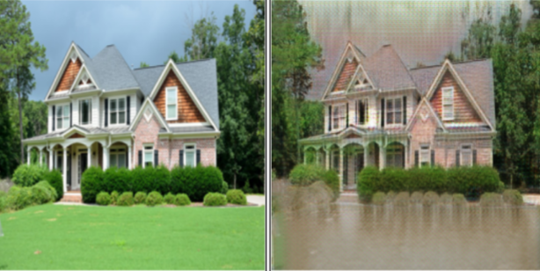
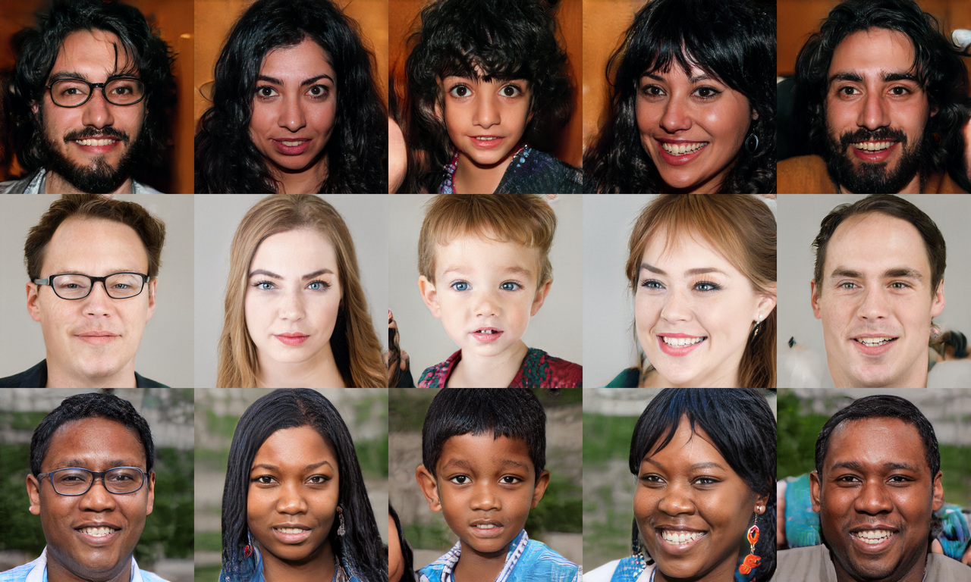
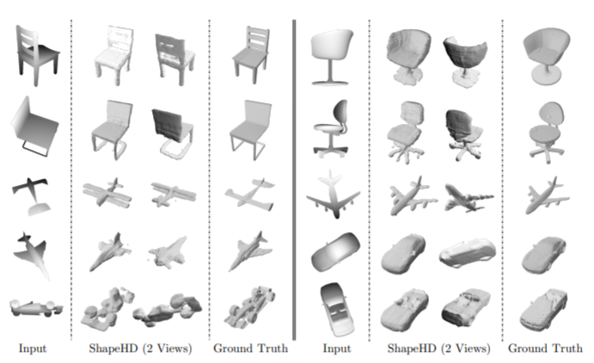

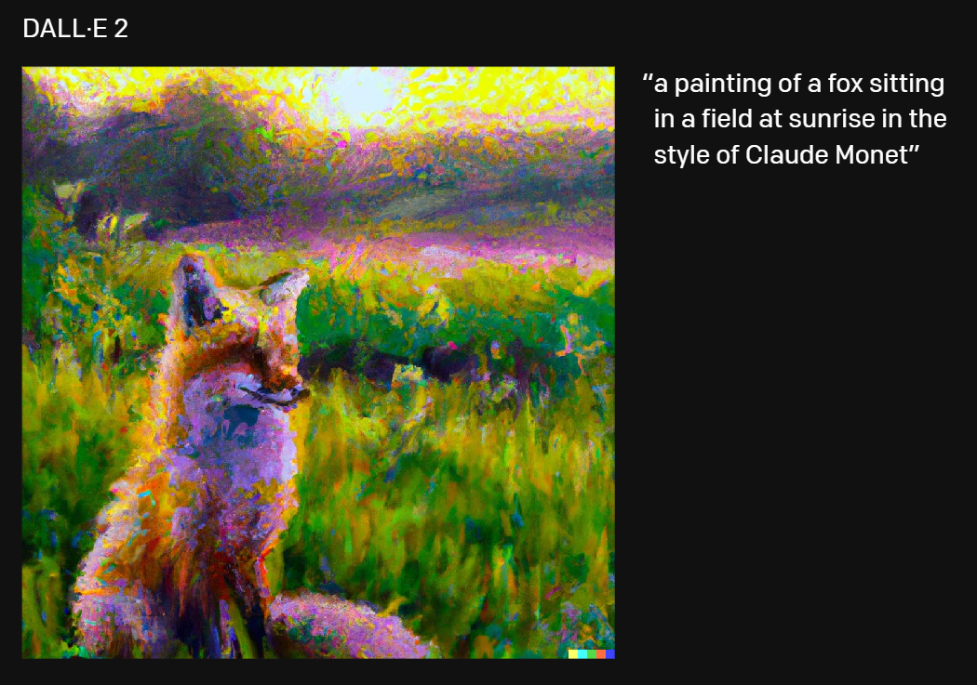
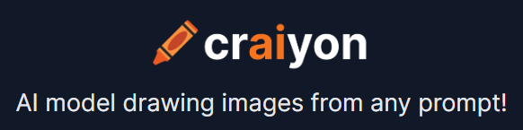
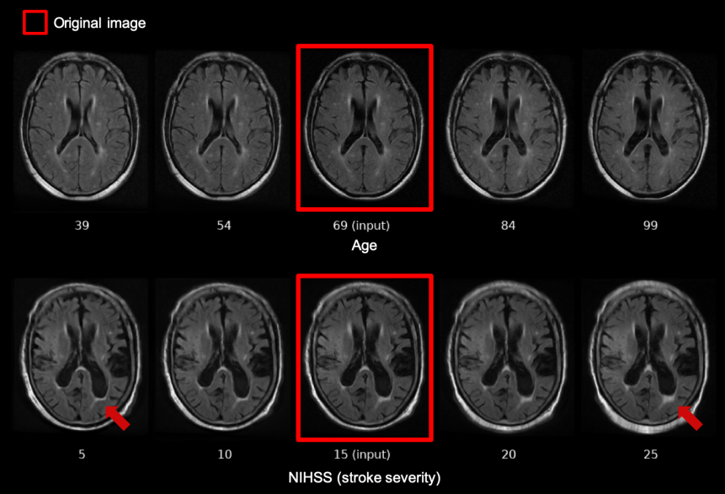

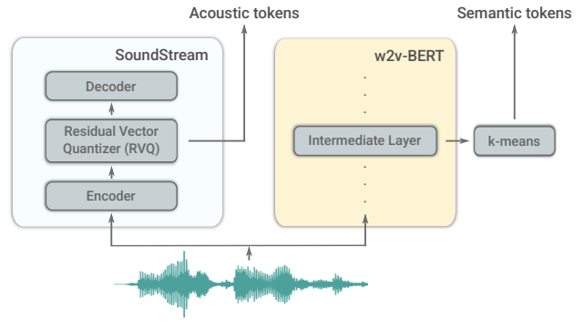
Generative models are used across a range of industries and applications.
developers.google.com/machine-learning/gan/generative openai.com/dall-e-2 github.com/NVlabs/stylegan github.com/xiumingzhang/GenRe-ShapeHD
Schmidt et al. arXiv:1905.03709, 2019. & github.com/junyanz/pytorch-CycleGAN-and-pix2pix Clinton Wang, MIT MSc thesis, 2020. google-research.github.io/seanet/audiolm

Slide 6
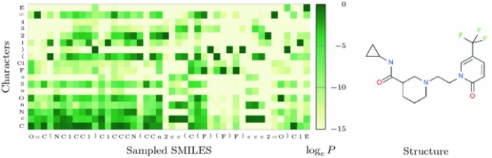
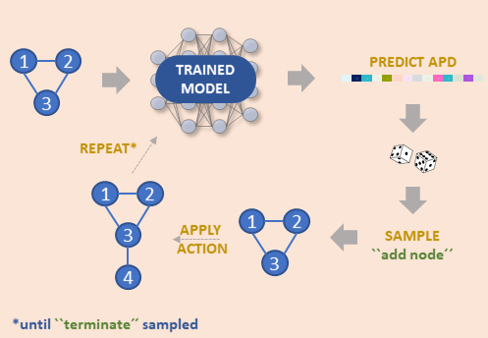
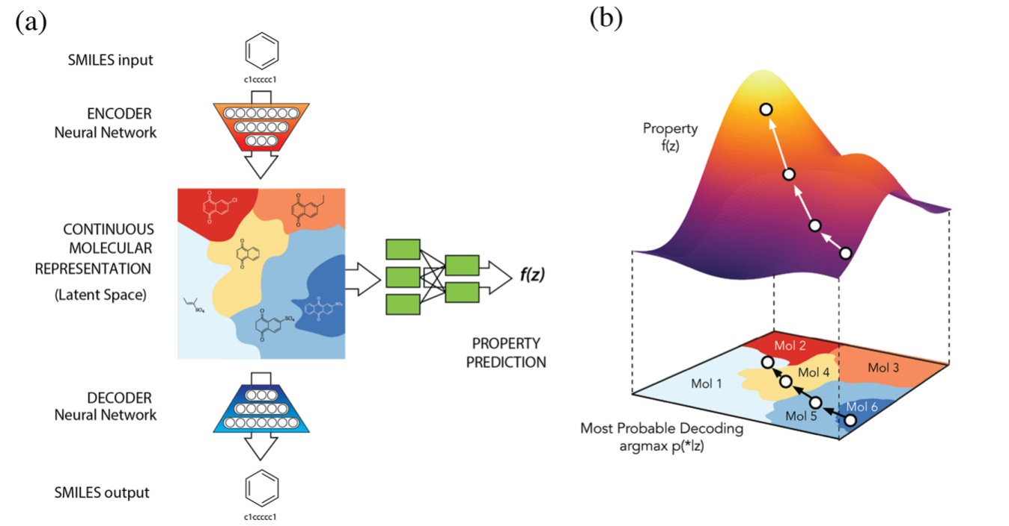
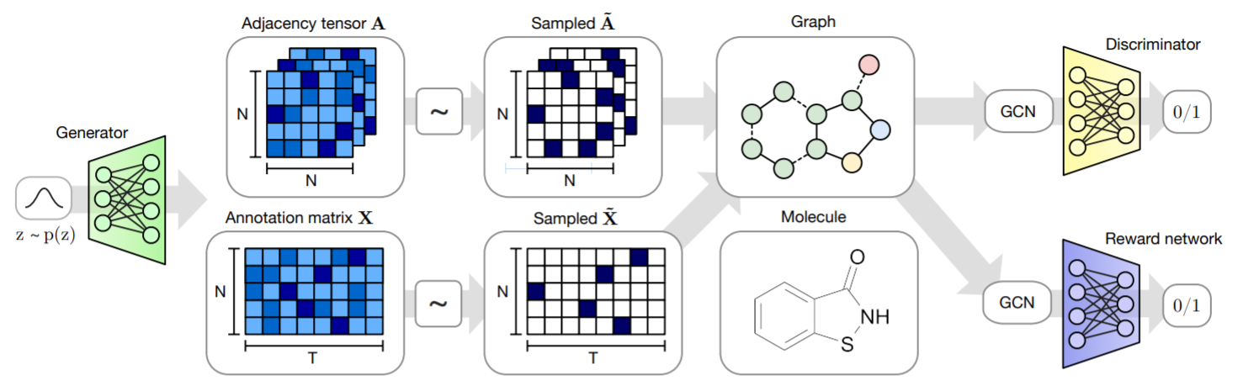
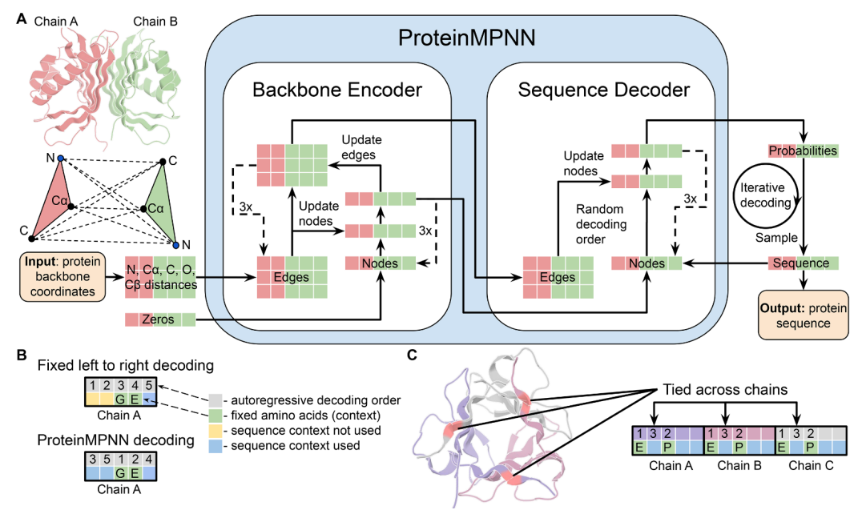
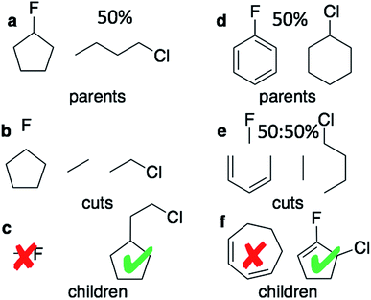
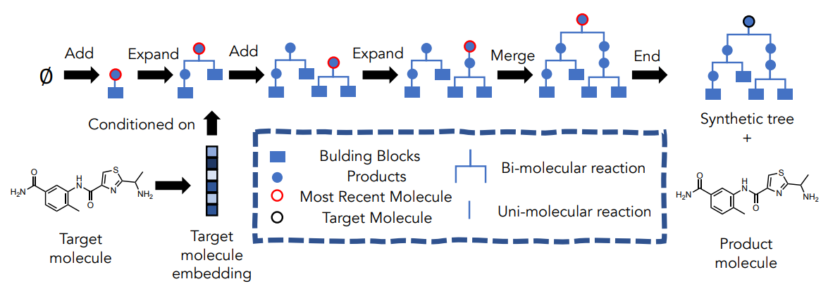
Generative models are also used for molecular engineering.
De Cao and Kipf. arXiv:1805.11973. 2018. Mercado et al. Mach. Learn.: Sci. Technol. 2021. Gómez-Bombarelli et al. ACS Cent. Sci., 2018, 4, 268−276. Gao et al. ICLR, 2022. Dauparas, Justas, et al. Science, 2022. Olivecrona, Marcus, et al. J. Cheminf., 2017, 1-14. Jensen, Jan H. Chemical Science, 2019, 3567-3572

Slide 7
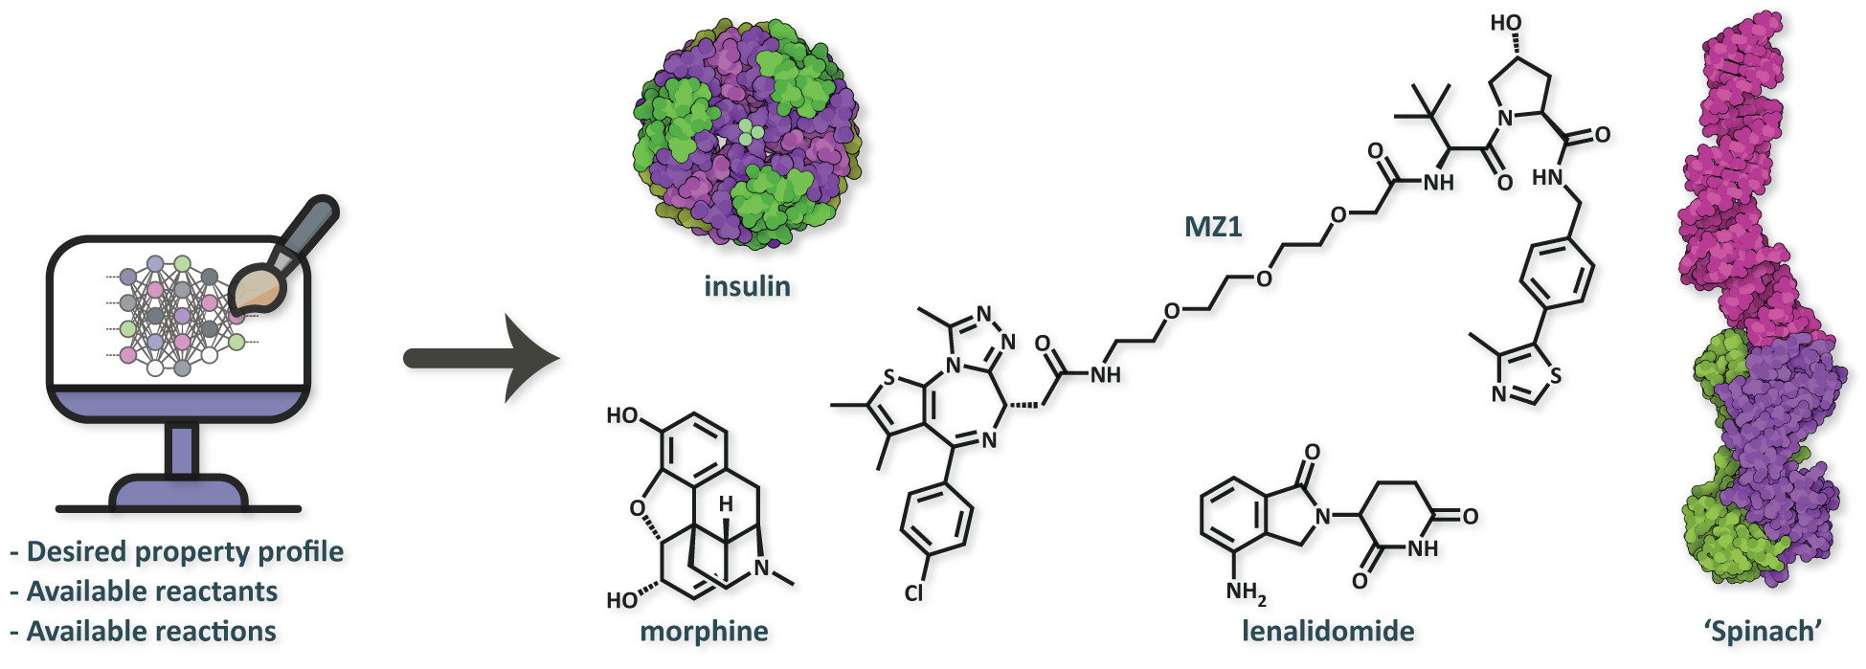
In early drug discovery, molecular DGMs can be used for de novo molecular design.
DGM

Slide 8
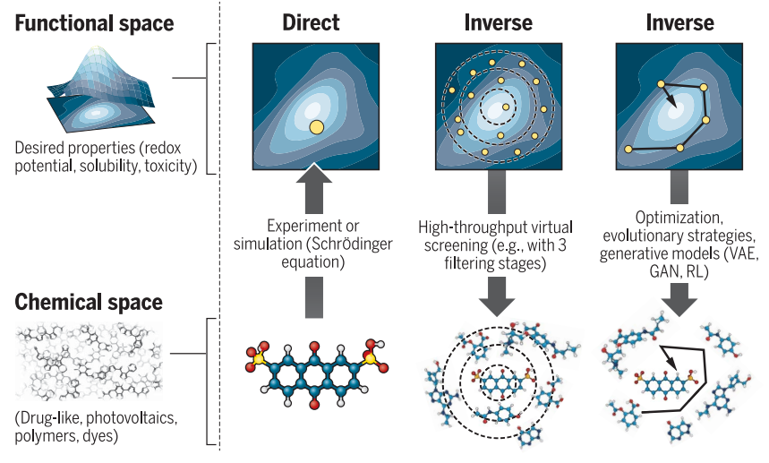
De novo molecular design is complementary to virtual screening.
virtual screening
de novo design
Figure form Sanchez-Lengeling, B. & Aspuru-Guzik, A. Science. 2018, 361(6400), 360–365.

Slide 9



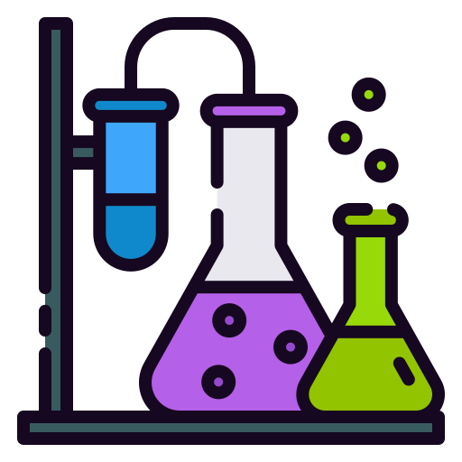
Ideally, de novo design leads to fewer DMTA cycles in drug development...
Design
Make
Test
Analyze
DMTA: ''design-make-test-analyze''
Notes:
Icons from Flaticon.com

Slide 10

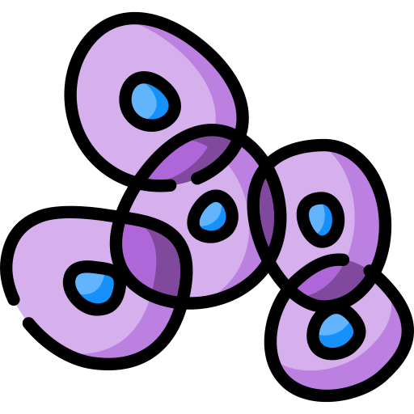





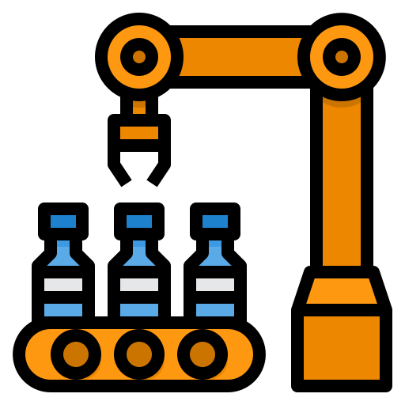


… and higher rates of success in clinical trials.
Discovery phase
Design
Make
Test
Analyze
Pre-clinical phase
Clinical phase
Manufacturing & regulatory approval
Models can also learn from billions of datapoints, and be continuously updated with new data!
Notes:
Icons from Flaticon.com

Slide 11
Building & benchmarking molecular deep generative models (DGMs)

Slide 12
Deep generative models generally consist of four main components.
Generation scheme
Single-shot
Autoregressive
Optimization algorithm
Reinforcement learning
Genetic algorithm
Molecular representation
Graphs
3D conformers
…
…
Bayesian optimization
Fingerprints
Strings
…
Deep learning architecture
GNNs
RNNs
FFNs
…
Figures from De Cao and Kipf. arXiv:1805.11973. 2018. and Gómez-Bombarelli et al. ACS Cent. Sci., 2018, 4, 268−276.

Slide 13
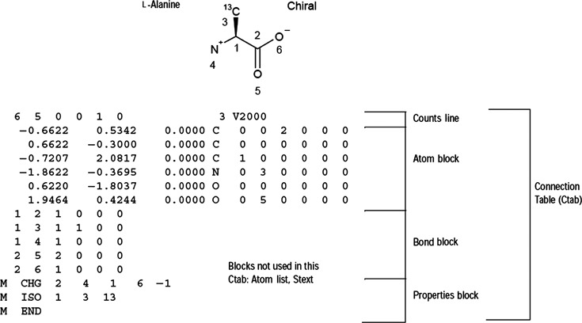
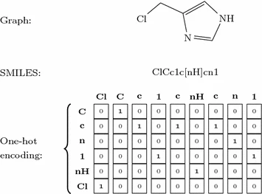
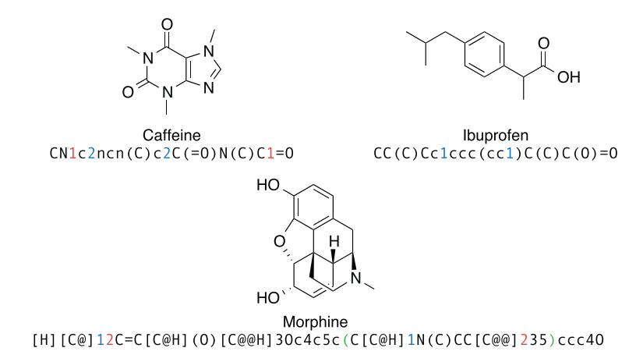
We can use a variety of representations to represent molecules in generative models.
molecular fingerprints
ECFPs
…
(2D) graph representations
connection tables
adjacency matrices
node feature matrices
edge feature tensors
…
string representations
SMILES
DeepSMILES
SELFIES
Rxn SMILES
…
3D representations
coordinates
bond lengths
bond angles
shape-filling models
…
Figures from: Segler et al. arXiv:1701.01329. 2017. Warr, Wendy. Molec. Inf., 2014, 33(6-7), 469–476.
Olivecrona et al. J. Cheminform., 2017, 9, 48.
review on molecular representations in AI-driven drug discovery
Molecular representations review
David et al. J. Cheminf. 2020.

Slide 14
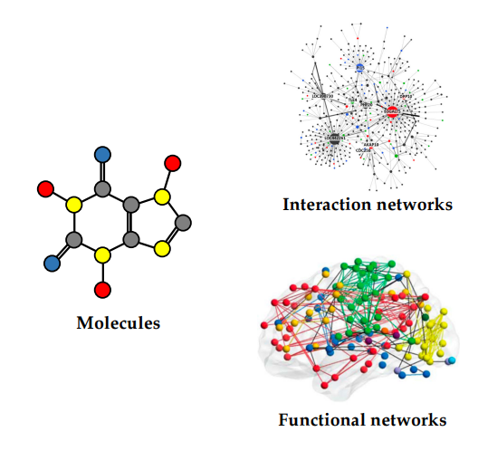
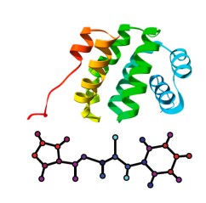
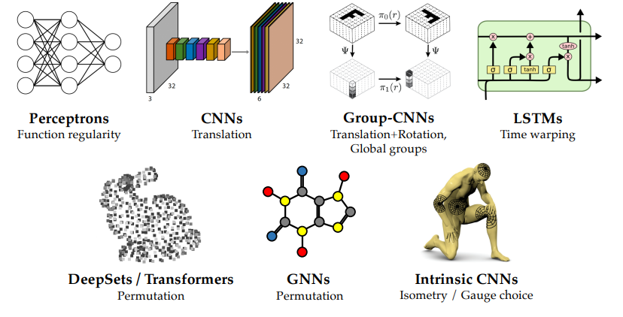
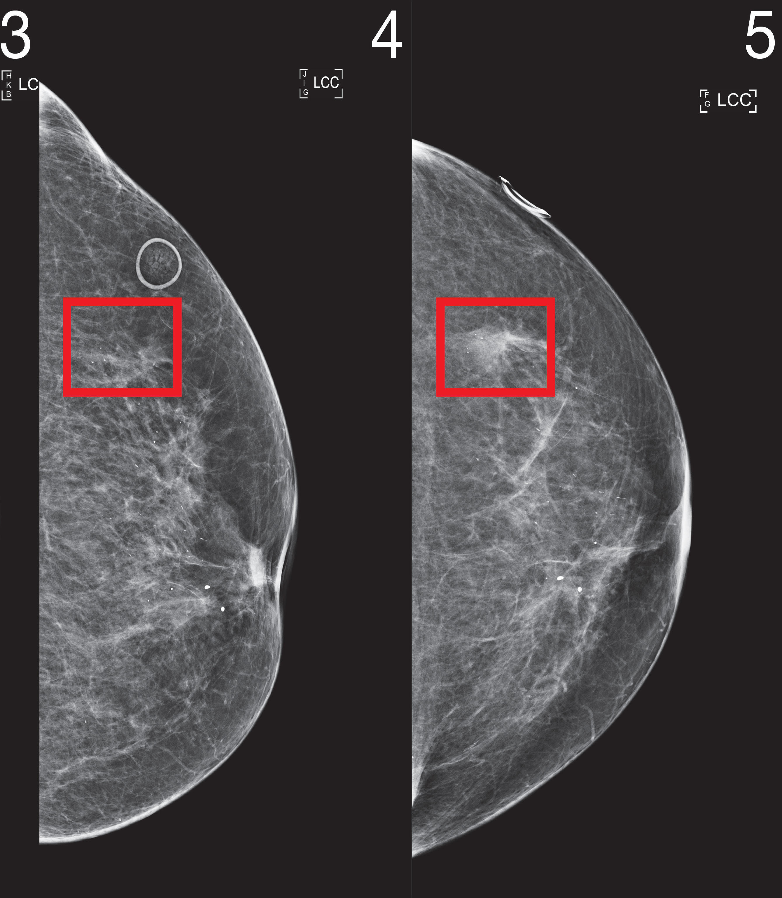
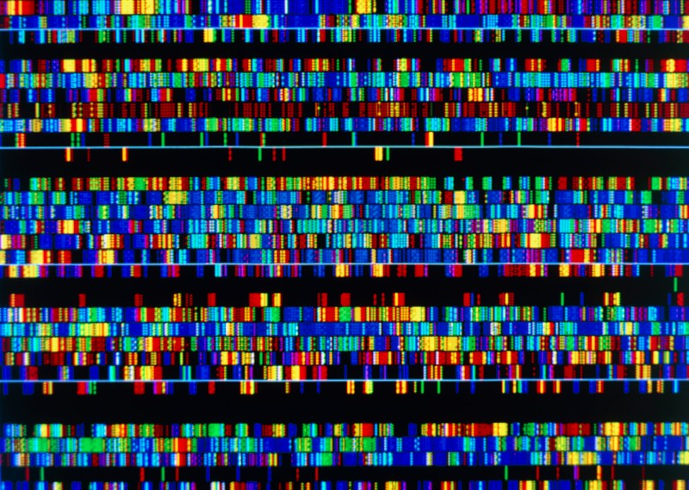


The unique structure of our data requires us to leverage the correct architecture/approach for that generation task.
Example data types
Example methods
Biomedical images
DNA sequences
Electronic health records
Figures from Bronstein, M. et al. Geometric Deep Learning, AAMI. 2021., csail.mit.edu/news/robust-ai-tools-predict-future-cancer, and https://www.nature.com/articles/d41586-021-01506-w.

Slide 15
There are two main generation schemes used.
(1) Single-shot and (2) iterative (autoregressive)

Slide 16
There are two main generation schemes used.
(1) Single-shot and (2) iterative (autoregressive)
sample
molecular generative model

Slide 17
There are two main generation schemes used.
(1) Single-shot and (2) iterative (autoregressive)
first sample:
molecular generative model
A
adjacency matrix

Slide 18
There are two main generation schemes used.
(1) Single-shot and (2) iterative (autoregressive)
then sample:
molecular generative model
X
node features

Slide 19
There are two main generation schemes used.
(1) Single-shot and (2) iterative (autoregressive)
Example:
MolGAN
De Cao and Kipf. arXiv:1805.11973. 2018.
github.com/nicola-decao/MolGAN

Slide 20
There are two main generation schemes used.
(1) Single-shot and (2) iterative (autoregressive)
sample
molecular generative model

Slide 21
There are two main generation schemes used.
(1) Single-shot and (2) iterative (autoregressive)
Example:
GraphINVENT
Mercado et al. Mach. Learn.: Sci. Technol. 2021.
github.com/MolecularAI/GraphINVENT

Slide 22
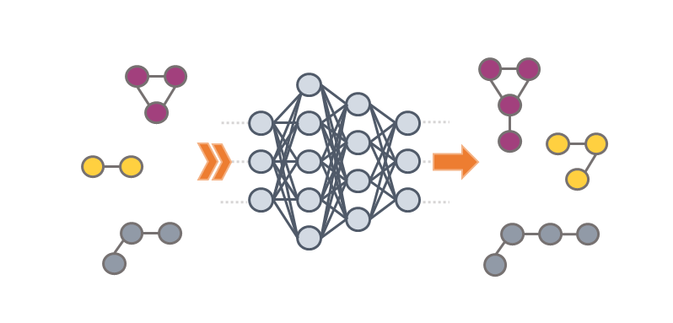
There are two main generation schemes used.
(1) Single-shot and (2) iterative (autoregressive)
(X, A)
GNN
(H^{L}, g)
Example:
GraphINVENT
APD
MLP
APD = action probability distribution
possible actions:
add edge/node
connect node
terminate graph
Mercado et al. Mach. Learn.: Sci. Technol. 2021.
github.com/MolecularAI/GraphINVENT

Slide 23
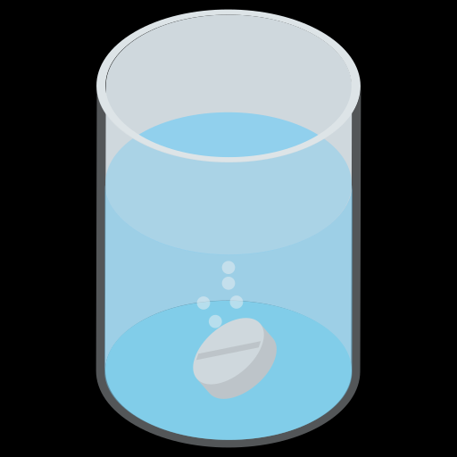
Optimizing for desired properties is a complex, multi-objective task.
Target activity
Target selectivity
Solubility
Lipophilicity
Permeability
Distribution
Synthetic accessibility
Novelty
Another protein
Adsorption
Clearance
Oral bioavailability
Plasma protein binding
Metabolic stability
Minimal negative drug-drug interactions
Formulation
Minimal production cost
X
X
X
binding pocket
X
X
Protein target
candidate molecules
Space of drug-like molecules:
10²³ – 10⁶⁰
Is it the right mechanism of action?
challenges
Large number of interdependent properties

Slide 24
A few common strategies for molecular optimization in generative models:
Transfer learning
Evolutionary algorithms
Bayesian optimization
Reinforcement learning

Slide 25
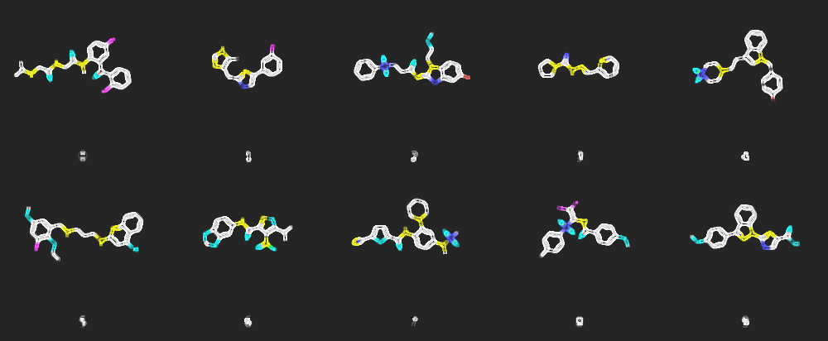
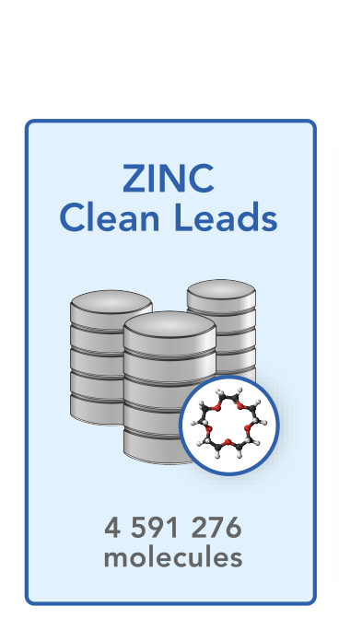
A few common strategies for molecular optimization in generative models:
Transfer learning
Evolutionary algorithms
Bayesian optimization
Reinforcement learning
DRD2 binders
JNK3 binders
GSK3β binders
(2) Fine-tune on a smaller set of specific binders
GM_{θ}
GM_{θ1}
DRD2
GM_{θ}
GM_{θ}
GM_{θ2}
JNK3
GM_{θ}
GM_{θ3}
GSK3β
(1) Train on a large set of drug-like molecules (e.g., ZINC Clean Leads)
GM_{θ}: generative model with parameters θ

Slide 26
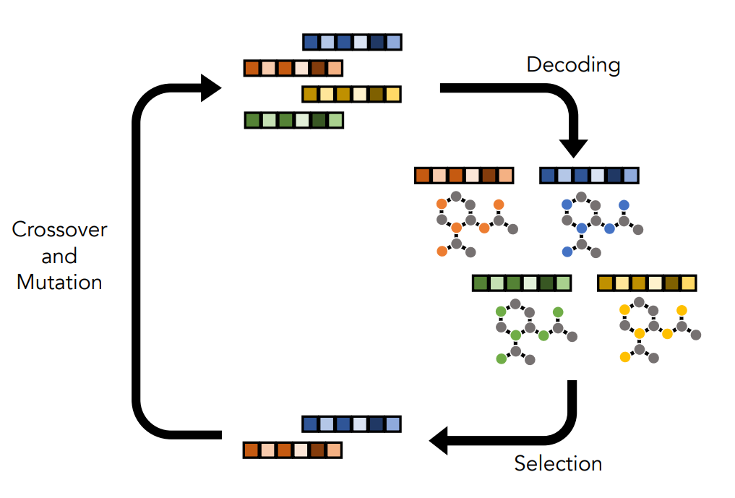
A few common strategies for molecular optimization in generative models:
Example 2:
SynNet
Transfer learning
Evolutionary algorithms
Bayesian optimization
Reinforcement learning
Example 1:
GraphGA
(1) Jensen, Jan H. Chemical Science, 2019, 3567-3572.
(2) Gao et al. ICLR. 2022.

Slide 27
A few common strategies for molecular optimization in generative models:
Transfer learning
Evolutionary algorithms
Bayesian optimization
Reinforcement learning

Slide 28
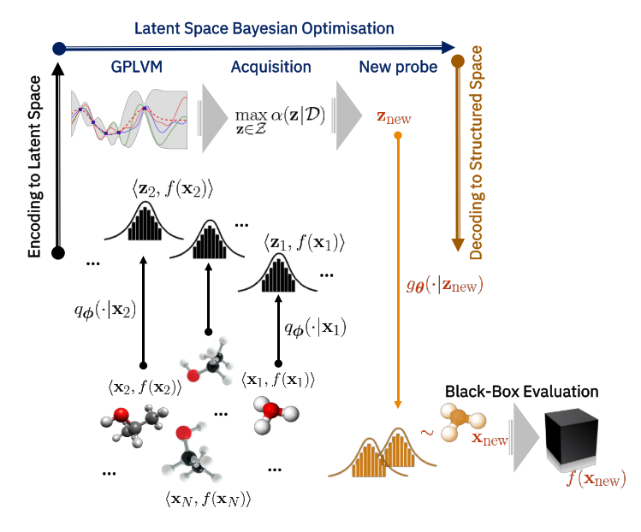
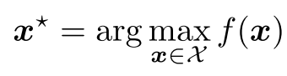
A few common strategies for molecular optimization in generative models:
Transfer learning
Evolutionary algorithms
Bayesian optimization
Reinforcement learning
Goal:
x = molecular representation
z = latent representation
f(·) = surrogate model (e.g., GP)
Figure from
Grosnit et al. arXiv:2106.03609. 2021.

Slide 29
A few common strategies for molecular optimization in generative models:
Example:
SMILES VAE
Transfer learning
Evolutionary algorithms
Bayesian optimization
Reinforcement learning
Gómez-Bombarelli et al. ACS Cent. Sci., 2018, 4, 268−276.

Slide 30
A few common strategies for molecular optimization in generative models:
Transfer learning
Evolutionary algorithms
Bayesian optimization
Reinforcement learning

Slide 31
A few common strategies for molecular optimization in generative models:
Transfer learning
Evolutionary algorithms
Bayesian optimization
Reinforcement learning
agent
generative model
reward
molecule building actions
molecule "score"
action
state
state
environment
new molecules

Slide 32
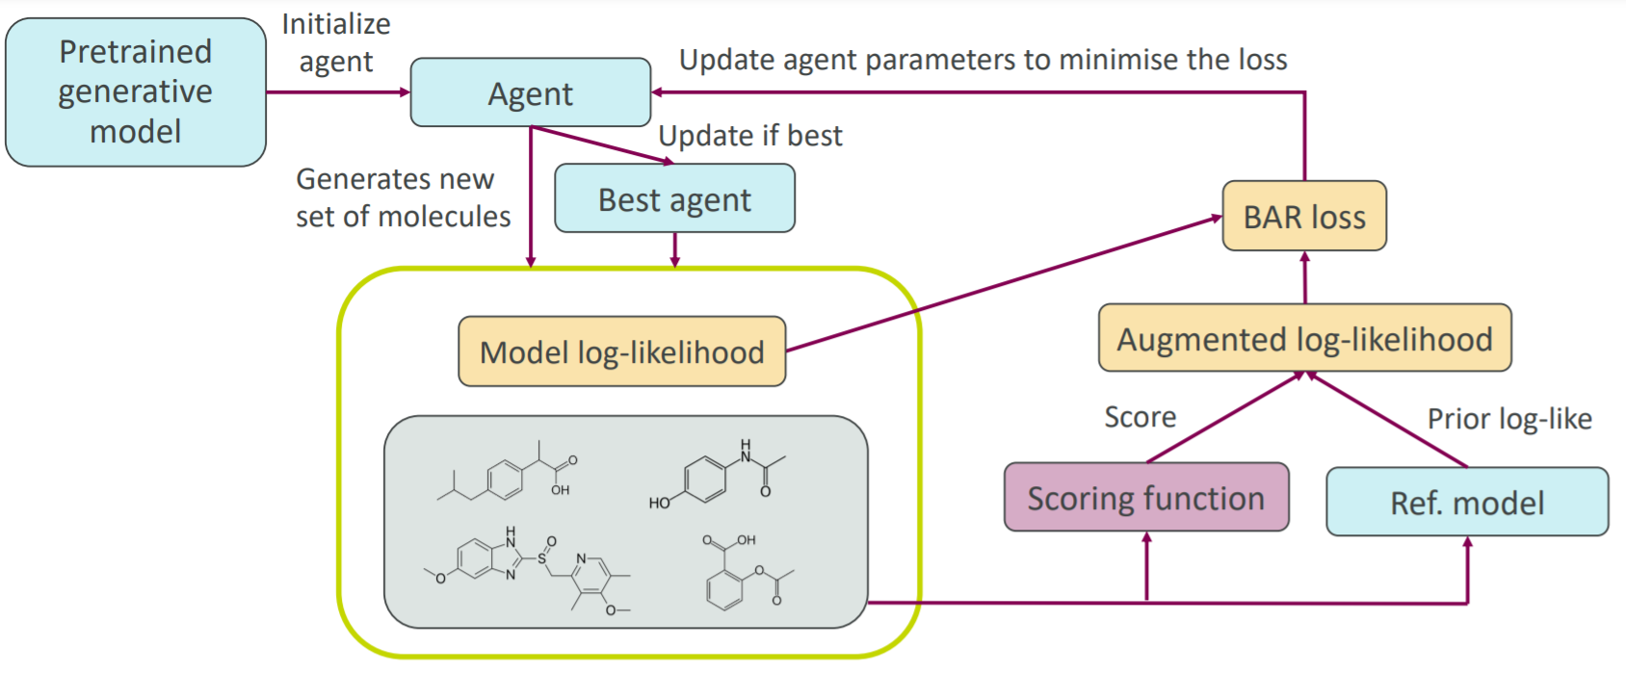
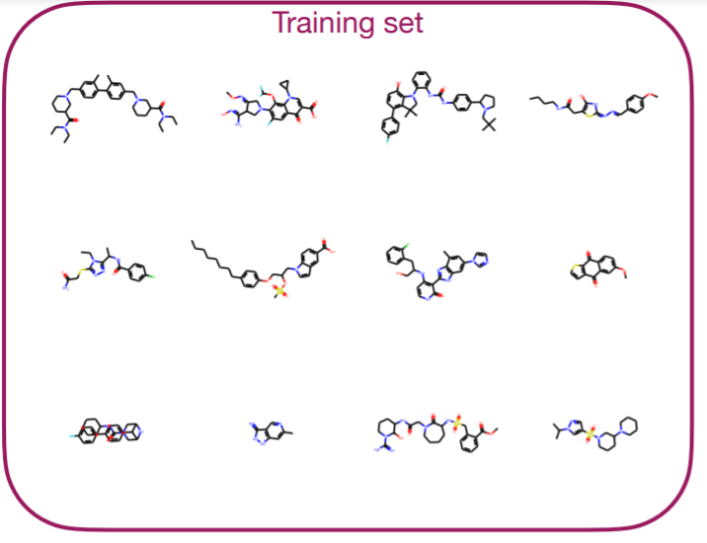
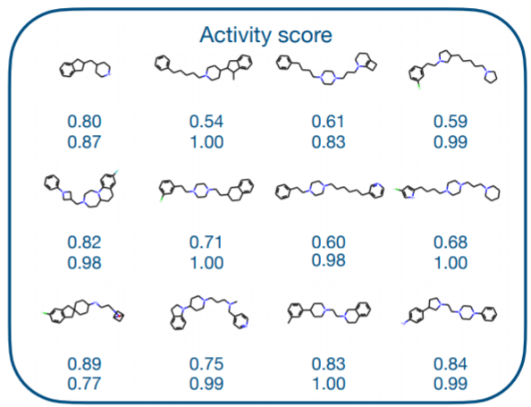
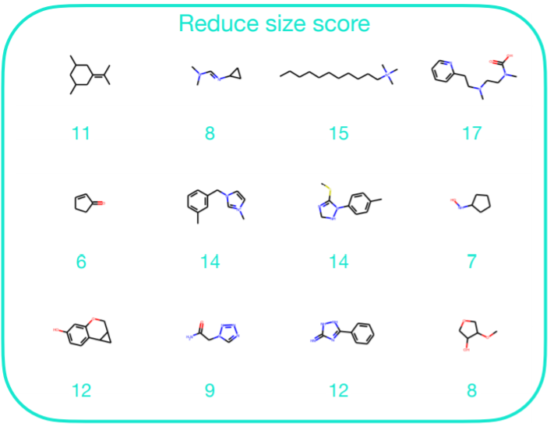
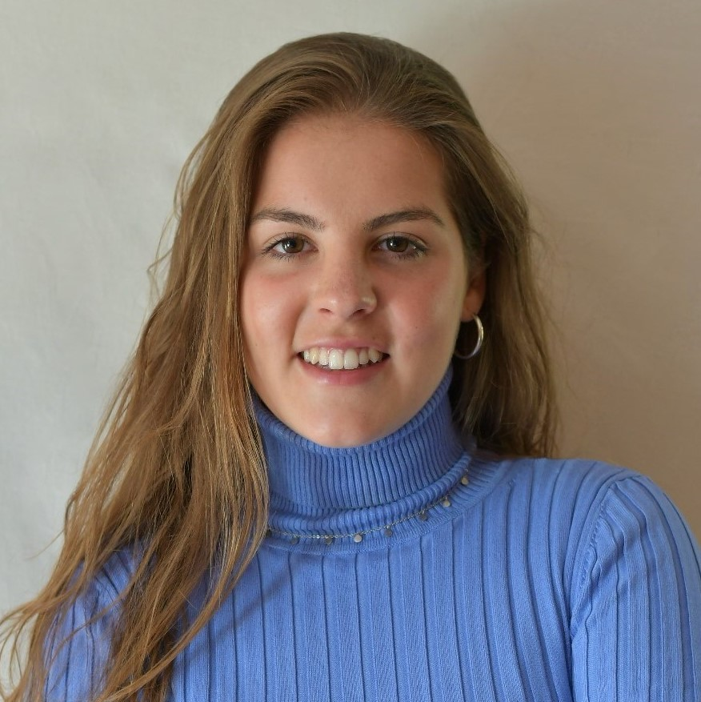


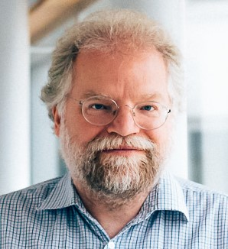
A few common strategies for molecular optimization in generative models:
Example:
GraphINVENT
Transfer learning
Evolutionary algorithms
Bayesian optimization
Reinforcement learning
Romeo Atance et al. JCIM. 2022. github.com/olsson-group/RL-GraphINVENT
Romeo Atance et al. ICML RL4RealLife Workshop. 2021. github.com/MolecularAI/GraphINVENT

Slide 33
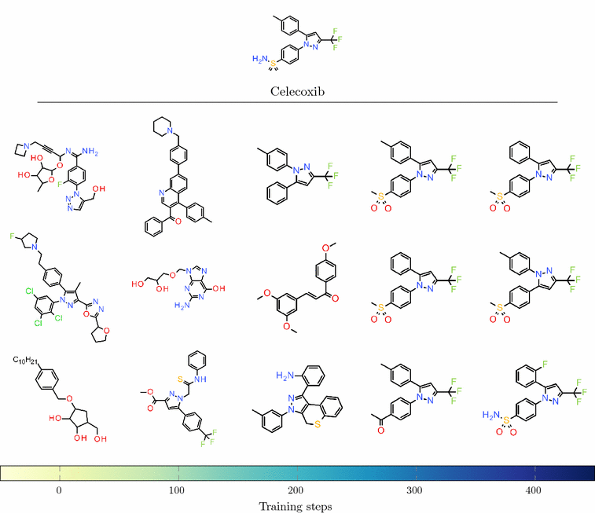
In molecular optimization, we want to balance exploration vs exploitation.
Example:
REINVENT
Figure from
Olivecrona et al. J. Cheminform., 2017, 9, 48.

Slide 34
How do we evaluate and compare molecular generative models?
Specific metrics:
Validity, novelty, uniqueness, diversity
Predicted activity scores
Chemical space coverage
Compare to virtual screening
…
Benchmarking frameworks:
MOSES
GuacaMol
Therapeutics Data Commons (TDC)
Practical Molecular Optimization (PMO)
…
See references at end of presentation

Slide 35
How do we evaluate and compare molecular generative models?
Specific metrics:
Validity, novelty, uniqueness, diversity
Predicted activity scores
Chemical space coverage
Compare to virtual screening
…
Benchmarking frameworks:
MOSES
GuacaMol
Therapeutics Data Commons (TDC)
Practical Molecular Optimization (PMO)
…
See references at end of presentation

Slide 36
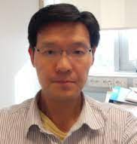

Evaluating generative models on chemical space coverage:
GDB-13
REINVENT performs best out of the various DGMs we benchmarked
chemical space coverage
(↑ better)
training set
generative model
GDB-13 small organic molecules, ≤13 HAs 975 million molecules {C, N, O, S, Cl}
How much of an enumerated database can a model generate having seen only 0.1% of it?
Arús-Pous et al. J Cheminform. 2019. 11, 20.
Zhang, Mercado et al. JCIM. 2021. 61, 6, 2572–2581.
36
See references at end of presentation

Slide 37
Exciting applications of molecular DGMs

Slide 38
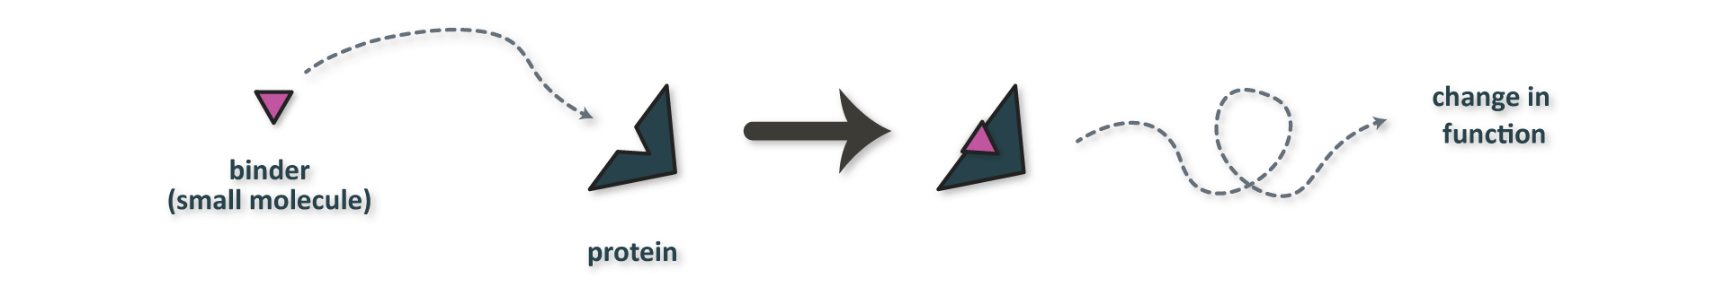
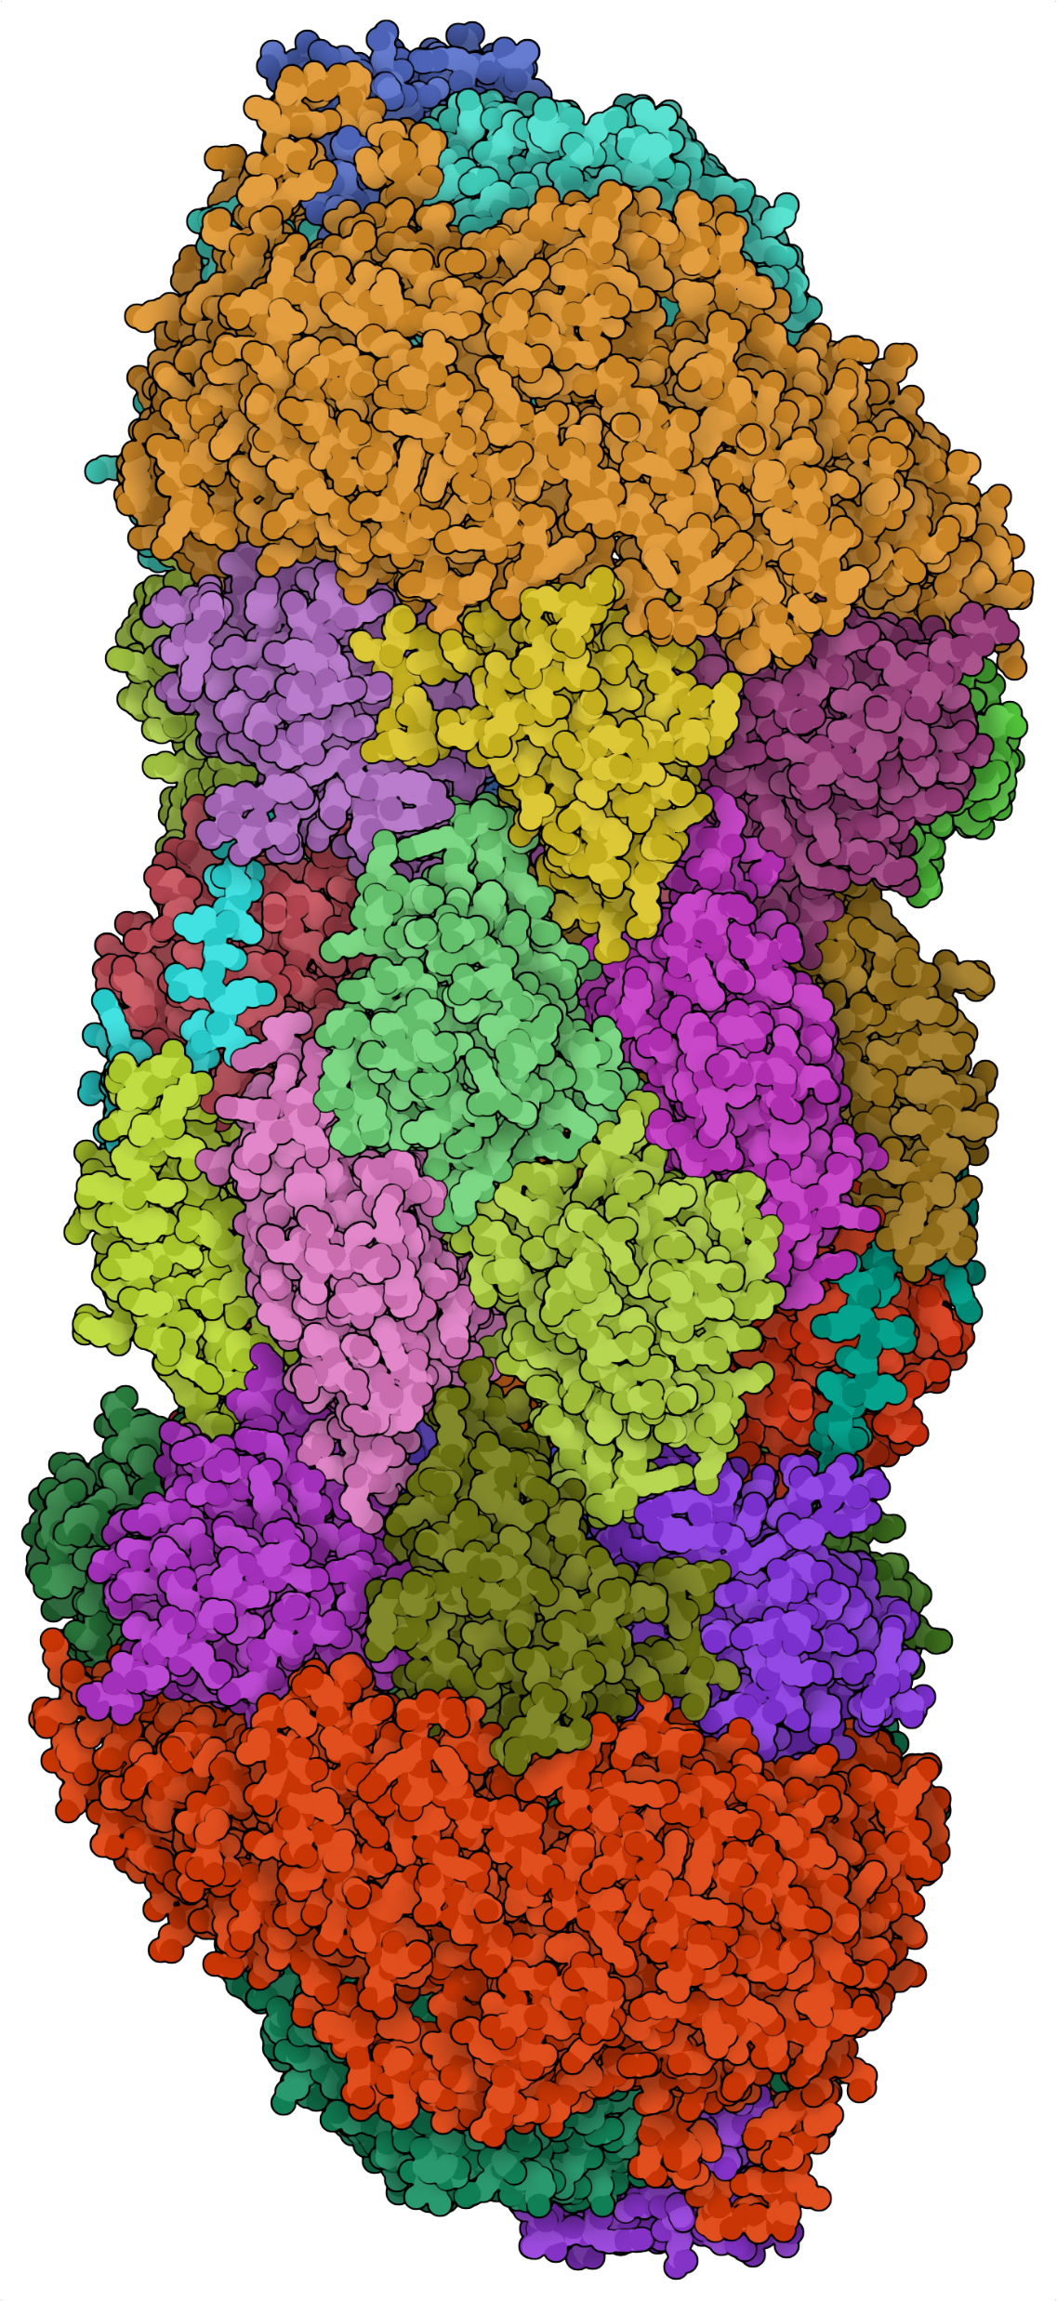
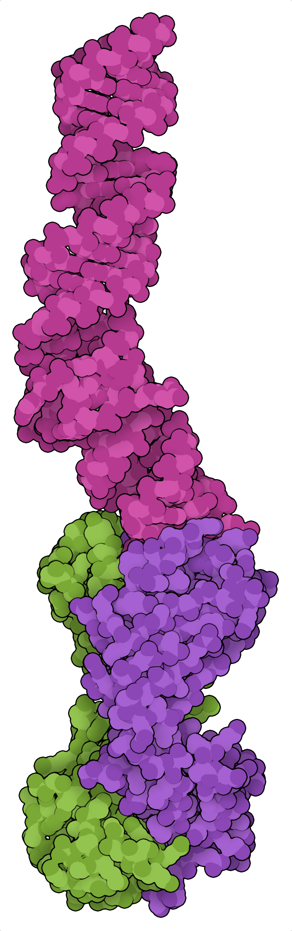

Most commonly, DGMs have been applied to the design of small molecule binders and proteins.

Slide 39


Can we use generative models to design bifunctional degraders?
Proteolysis Targeting Chimeras (PROTACs) for targeted protein degradation
weak binding affinity
catalytic mechanism
can target broader range of proteins at lower doses

Slide 40





DGMs can be used to optimize bifunctional degraders.
empty graph
GraphINVENT
Nori et al. AI4Science NeurIPS 2022 Workshop. 2022.

Slide 41

Rewarding molecules based on a surrogate model for protein degradation activity leads to enhanced sampling of active molecules.
40% → 80% predicted highly active degraders
100% novel structures
Nori et al. AI4Science NeurIPS 2022 Workshop. 2022.

Slide 42
We can also use DGMs for synthesizability-constrained molecular generation.
Synthesizability-constrained molecular generation: the generation of molecules which are guaranteed to be synthesizable using known chemical reactions and available building blocks.
Gao et al. arXiv. 2021.
Gao et al. ICLR 2022. 2022. Icon from: flaticon.com/premium-icon/chemistry_3223827

Slide 43


We can also use DGMs for synthesizability-constrained molecular generation.
generative model
synthesis tree
molecular embedding
optimized molecule
potential synthesis route
SynNet
github.com/wenhao-gao/SynNet
Gao et al. arXiv. 2021.
Gao et al. ICLR 2022. 2022.

Slide 44
We can also use DGMs for synthesizability-constrained molecular generation.
github.com/wenhao-gao/SynNet
Gao et al. arXiv. 2021.
Gao et al. ICLR 2022. 2022.

Slide 45


We can also use DGMs for synthesizability-constrained molecular generation.
github.com/wenhao-gao/SynNet
Gao et al. arXiv. 2021.
Gao et al. ICLR 2022. 2022.

Slide 46


SynNet can generate synthesis trees and synthesizable analogues.
model input
final output
model input
final output
github.com/wenhao-gao/SynNet
Gao et al. arXiv. 2021.
Gao et al. ICLR 2022. 2022.

Slide 47




SynNet v2.0
github.com/wenhao-gao/SynNet
Gao et al. arXiv. 2021.
Gao et al. ICLR 2022. 2022.

Slide 48









Can we use meta-learning for the optimization of small molecule binders?
Aim: Discover novel binders for a new protein target with few known binders.
Challenge: Experiments (oracle calls) are costly. Use as few as possible.
PPARα
BACE1
THRB
ADAM17
Can we use meta-learning to leverage data on related tasks?
ESR2
extensive data on many other targets
MAML: Finn et al. ICML. 2017. arXiv:1703.03400. DOCKSTRING: García-Ortegón et al. 2021 arXiv:2110.15486. REINVENT: Blaschke et al. 2020. J. Chem. Inf. Model. 60, 12, 5918–5922.
Notes:
Icons from Flaticon.com

Slide 49





Can we use meta-learning for the optimization of small molecule binders?
Docking surrogate
2
Pre-train
3
4
Meta-train
RL fine-tuning
SMILES LSTM
1
CC(C)Cc1ccc(cc1)C(C)C…
various
baseline
RL fine-tuning
top-N
baseline
Virtual screening
MAML: Finn et al. ICML. 2017. arXiv:1703.03400. DOCKSTRING: García-Ortegón et al. 2021 arXiv:2110.15486. REINVENT: Blaschke et al. 2020. J. Chem. Inf. Model. 60, 12, 5918–5922.
Notes:
Icons from Flaticon.com

Slide 50







Can we use meta-learning for the optimization of small molecule binders?
Depends on the target. Usually not more effective than single-task training alone.
(-) Worse docking scores than single-task training alone
(+) Higher drug-likeness & novelty
(+) Better docking scores than VS
meta-learning in theory
meta-learning in practice
Open questions:
For which targets will meta-training help?
Are specific task groupings > others?
https://i.kym-cdn.com/entries/icons/original/000/038/908/twoguysonabusheader.jpg
MAML: Finn et al. ICML. 2017. arXiv:1703.03400. DOCKSTRING: García-Ortegón et al. 2021 arXiv:2110.15486. REINVENT: Blaschke et al. 2020. J. Chem. Inf. Model. 60, 12, 5918–5922.

Slide 51




Introductory resource to DL in chemistry: dl-chem-101
github.com/rociomer/dl-chem-101

Slide 52
Summary & outlook
Also, Acknowledgments and References for further reading

Slide 53
Talk summary
Previous and active work on the development of open source, data-driven molecular design tools:
Graph-based deep generative model (GraphINVENT) using reinforcement learning
Synthesizability-constrained molecular design (SynNet)
PROTAC design using GraphINVENT
Meta-learning for molecular optimization (MaLMO)
Introductory resources for deep learning in chemistry (dl-chem-101)
The results of these works are steps towards improved DGMs for drug discovery applications, but can also be used in other domains.
Final words: always publish the code! Unpolished code is better than no code.

Slide 54
Deep molecular generative models are not only cool,
but they are already impacting the way we discover drugs.

Slide 55




AI-based drug discovery companies have 18 assets in clinical trials (8/22).
Benaich and Hogarth, State of AI Report, 2022, stateof.ai investors.exscientia.ai/press-releases/ https://insilico.com/phase1 ir.recursion.com

Slide 56





AI Laboratory for Biomolecular Engineering (AIBE) @ Chalmers
masterthesis.cms.chalmers.se/supervisor/rocio-mercado
Coming to Sweden January 2023!
ailab.bio
rocom@chalmers.se

Slide 57






Acknowledgments
Molecular AI group: Sara Romeo Atance Juan Viguera Diez Julio Ponte Hernández Tobias Rastemo Edvard Lindelöf Dr. Atanas Patronov Dr. Samuel Genheden Dr. Esben J. Bjerrum Dr. Ola Engkvist Prof. Hongming Chen
Chalmers, especially: Prof. Simon Olsson
Miscellaneous: Prof. Günter Klambauer Jeff Guo
Coley group: Wenhao Gao Divya Nori Dr. Aparajita Dasgupta Dr. Thijs Stuyver
Dr. Matteo Aldeghi
Dr. John Bradshaw
Dr. Guangqi Wu
David Graff Itai Levin Christian Ulmer Divya Nori Prof. Connor Coley
Jenna Fromer Samuel Goldman
Priyanka Raghavan
Zhengkai Tu
Keir Adams
Herry (Tianyi) Jin Rebecca Neeser
Mingrou Xie
Coley lab apple picking, October 2022
Thank you for your attention.
contact info
@rociomer3 rocom@chalmers.se rociomer.github.io

Slide 58
References and recommended reading
Molecular and reaction representations:
David et al. J. Cheminf., 2020, 12:56. link
Warr, Wendy. Molec. Inf., 2014, 33(6-7), 469–476. link
Benchmarks and evaluation frameworks for molecular generative models:
(MOSES) Polykovskiy et al. arXiv:1811.12823, 2020. link
(Guacamol) Brown et al. J. Chem. Inf. Model., 2019, 59, 3, 1096–1108. link
(Chemical space coverage) Arús-Pous et al. J Cheminform., 2019, 11:20. link
(Therapeutics Data Commons) Huang et al. Proc. NeurIPS, 2021. link
(PMO) Gao et al. arXiv, 2022. link
Deep molecular generative models mentioned in this talk:
(SMILES LSTM) Segler et al. arXiv:1701.01329. 2017. link
(REINVENT) Olivecrona et al. J. Cheminform., 2017, 9, 48. link & Blaschke et al. JCIM, 2020, 60, 12, 5918-5922. link
(MolGAN) De Cao and Kipf. arXiv:1805.11973. 2018. link
(SMILES VAE) Gómez-Bombarelli et al. ACS Cent. Sci., 2018, 4, 268−276. link
(GraphGA) Jans Jensen, Chem. Sci., 2019, 12. link
(GraphINVENT) Mercado et al. Mach. Learn.: Sci. Tech., 2021, 2, 025023. link
(RL-GraphINVENT) Romeo Atance et al. JCIM, 2022. link
(SynNet) Gao et al. ICLR, 2022. link code
(ProteinMPNN) Dauparas et al. Science, 2022. link

